Slide 1
Norwegian Life and Society
THE NORWEGIAN LEGAL SYSTEM
Thomas Horn
Attorney-at-law, admitted to the Supreme Court
Phd Research fellow, Dept. of Public and International Law UiO
10th October 2011

Slide 2
Some questions for reflection:
Legal systems:
What is a legal system?
Why do we need a legal system?
Which institutions does the legal system consist of?
Need for “checks and balances”?
The Norwegian legal system:
Similar or different from other legal systems?
Institutions different?
Way of thinking different?
Material rights different?

Slide 3
Foundation: The Constitution of 1814
Historic situation 1814
Inspiration: USA and France, Peoples right of self determination
Radical content
Constitutional Monarchy - Sovereignty of the People
Division of powers
Judicial review? Constitution legally binding?
Yes (confirmed Supreme Court mid 19th century)
Judicial review in other European countries

Slide 4
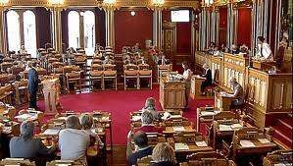
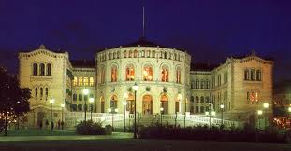
The Parliament (Stortinget) – the legislative branch
Power to issue new legislation
The Principle of legality
  Rule of Law
  Peoples sovereignty
  Citizens able to foresee their legal position
The principle of non-retroactivity

Slide 5
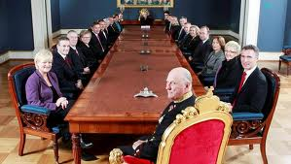
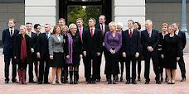
The Government – the executive branch
Legislative process:
Substantial influence on the legislative process (“lov”)
Power to issue new directives (“forskrifter”)
Executive power – enforcing legal order:
Criminal cases
Civil cases

Slide 6
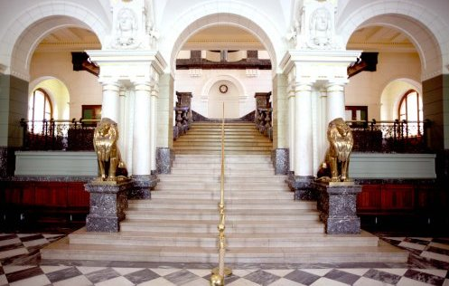
The Court System
- the judicial branch
The independence of Courts
Tasks of the Courts
  Criminal cases
    No investigative courts
  Civil cases
    Not all disputes settled in courts of law
    Conciliation proceedings
    Courts of law not fit for all kinds of disputes – only legal matters

Slide 7
Court system
Supreme
Court
“Høyesterett”
Appeals Courts
”Lagmannsretten”
District Courts
”Tingretten”

Slide 8
District Courts
70 District Courts in Norway
Jurisdiction in all matters
  No division of ordinary courts and administrative courts
  No division of criminal courts and civil courts
  No separate constitutional court
Appeals Courts
Only 6 Appeals Courts in Norway
Right to appeal
  Civil cases
  Criminal cases

Slide 9
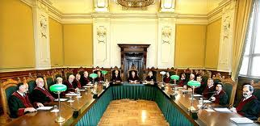
Supreme Court
Right to appeal heavily restricted
Purpose of Supreme Court
  Not to ensure right outcome in each and every case in Norway
  Ensure uniformity of legal process
  Resolve matters where the law is unclear
  Develop the law
  Decide in matters of principle

Slide 10
Composition of the Courts
Professional judges
District Courts: 1
Appeals Courts: 3
Supreme Court: 5
Supreme Court
- plenary session: 19
Lay judges
Civil cases:
None, but parties may demand
Criminal cases:
Lay judges in majority

Slide 11
Court proceedings and hearings
Civil cases
Strong oral tradition
Witnesses, documentary evidence and legal arguments presented directly before the court during “main hearing”
Criminal cases
Oral tradition even stronger
Judges as "tabula rasa”
Presumption of innocence
Evaluation of evidence
Principle of contradiction
Principle of transparency

Slide 12
Norwegian legal system compared to other western legal systems
Continental law
Extensive and detailed legislation
Principles of law
Common law
Case-law developed by Courts of law
Tradition
Norwegian law
Parliamentary legislation key figure
Legislation less detailed
Trusts the courts to find “the spirit of the law”
Still, courts heavy emphasis on legislators “preparatory works”
Supreme Court case-law highly important
Courts recognised to “develop law”
Scandinavian “legal pragmatism” – less principles

Slide 13
Some major trends in the Norwegian legal system
Wide administrative powers in the aftermath of WWII
Increased protection of citizen’s position
Consumer protection
Deregulation – more free market
EU/EØS-legislation
Soft on crime – or tougher on crime?
Human Rights
The aftermath of the Utøya-massacre?

